Slide 1
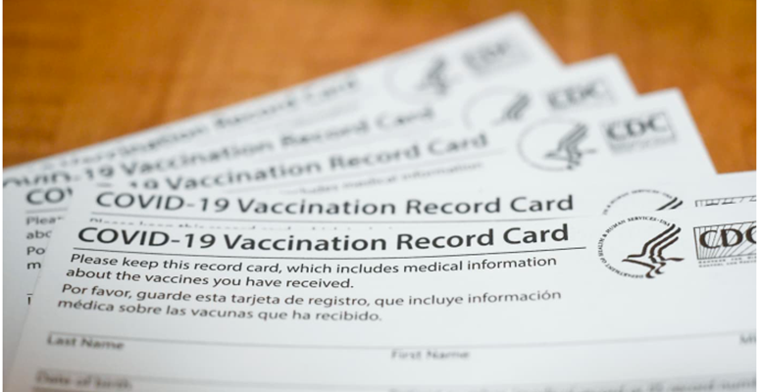
COVID-19 Vaccine Safety & Efficacy
Danielle Turner, PhD

Slide 2
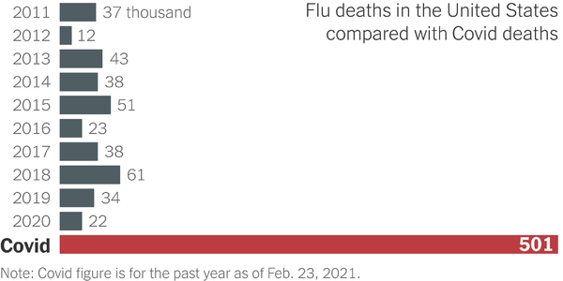

Slide 4
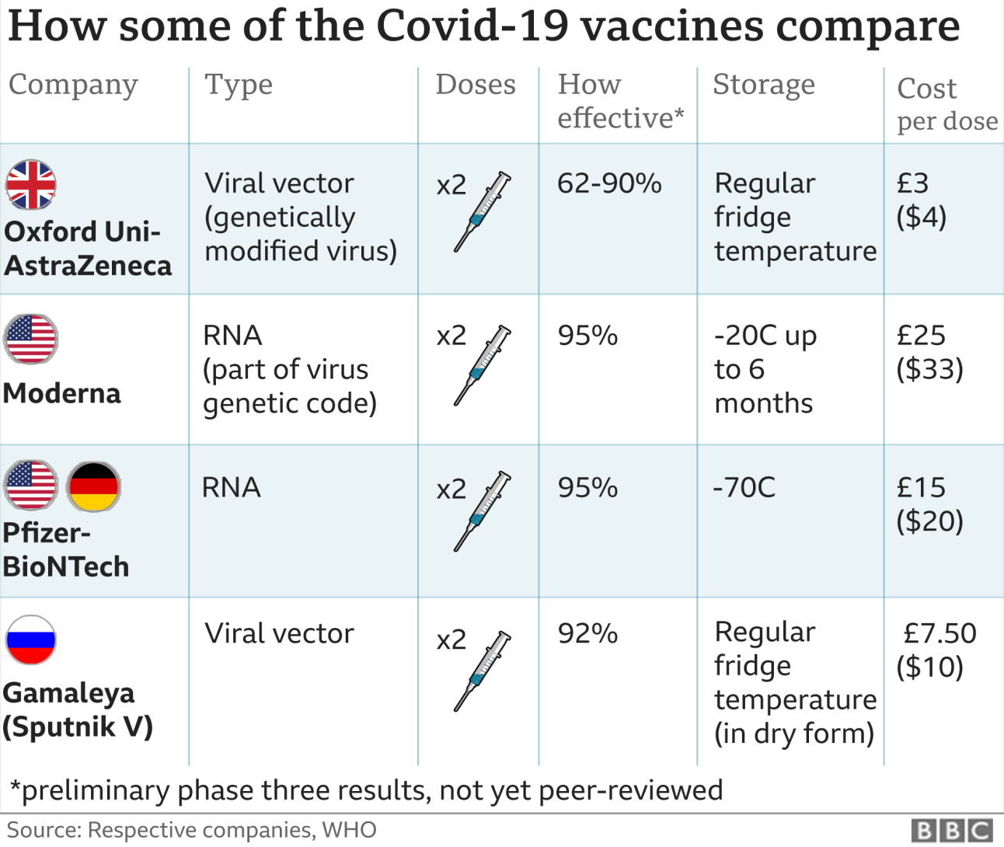
Comparing current vaccines efficacy & cost
https://www.bbc.com/news/health-54993652
https://www.nytimes.com/interactive/2021/health/gamaleya-covid-19-vaccine.html
https://www.nytimes.com/interactive/2020/health/oxford-astrazeneca-covid-19-vaccine.html

Slide 5
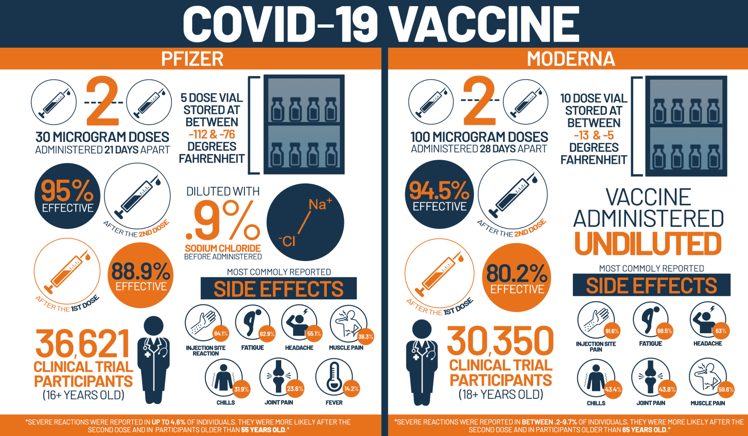
Pfizer vs. Moderna
Pfizer COVID-19 vaccine FDA report released ahead of emergency use meeting

Slide 6
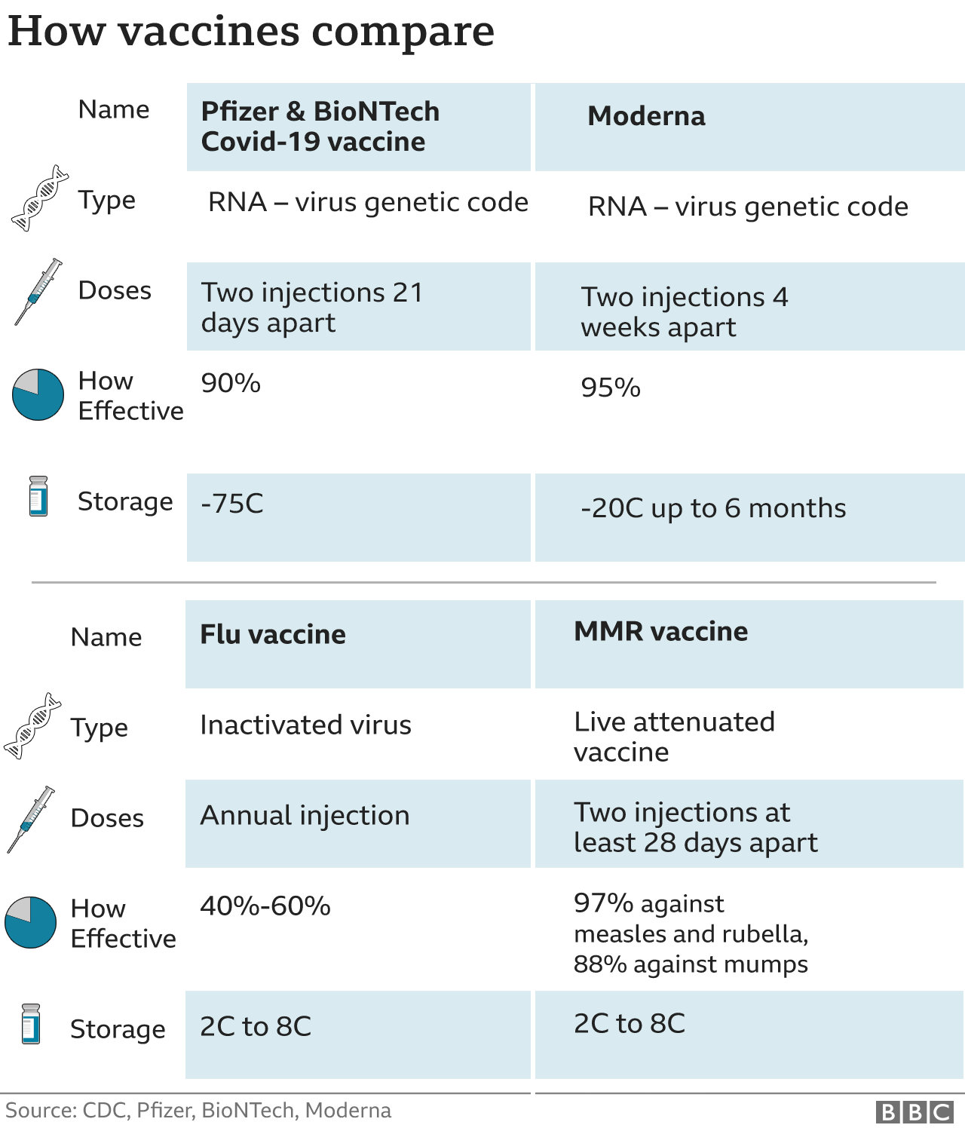
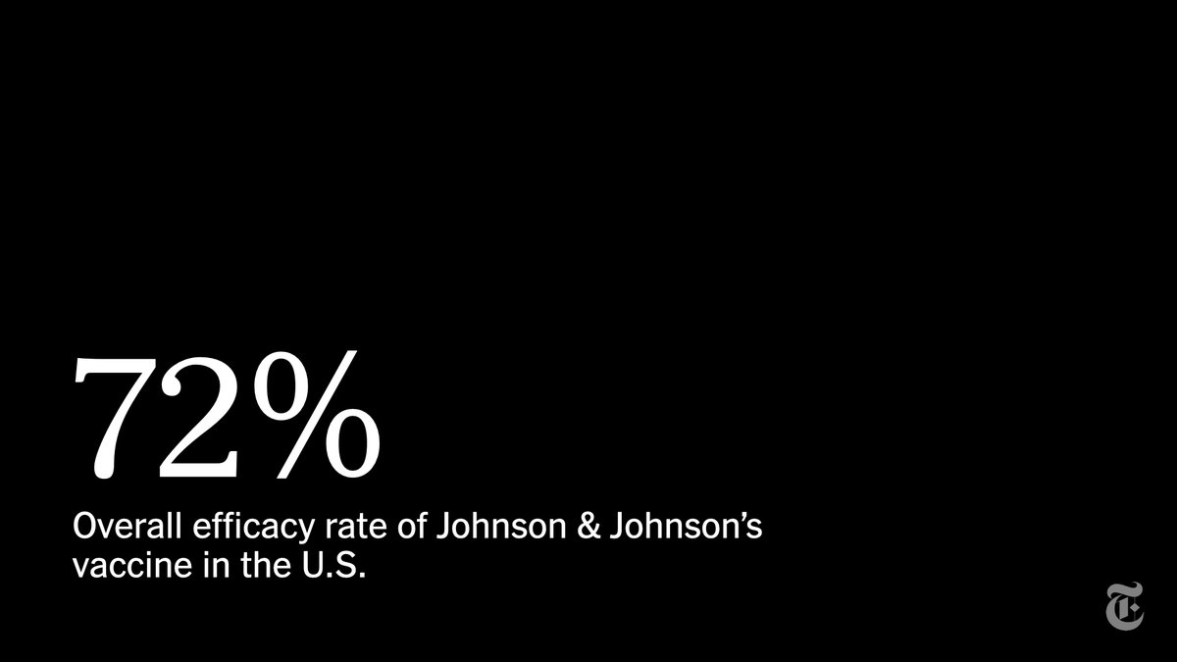
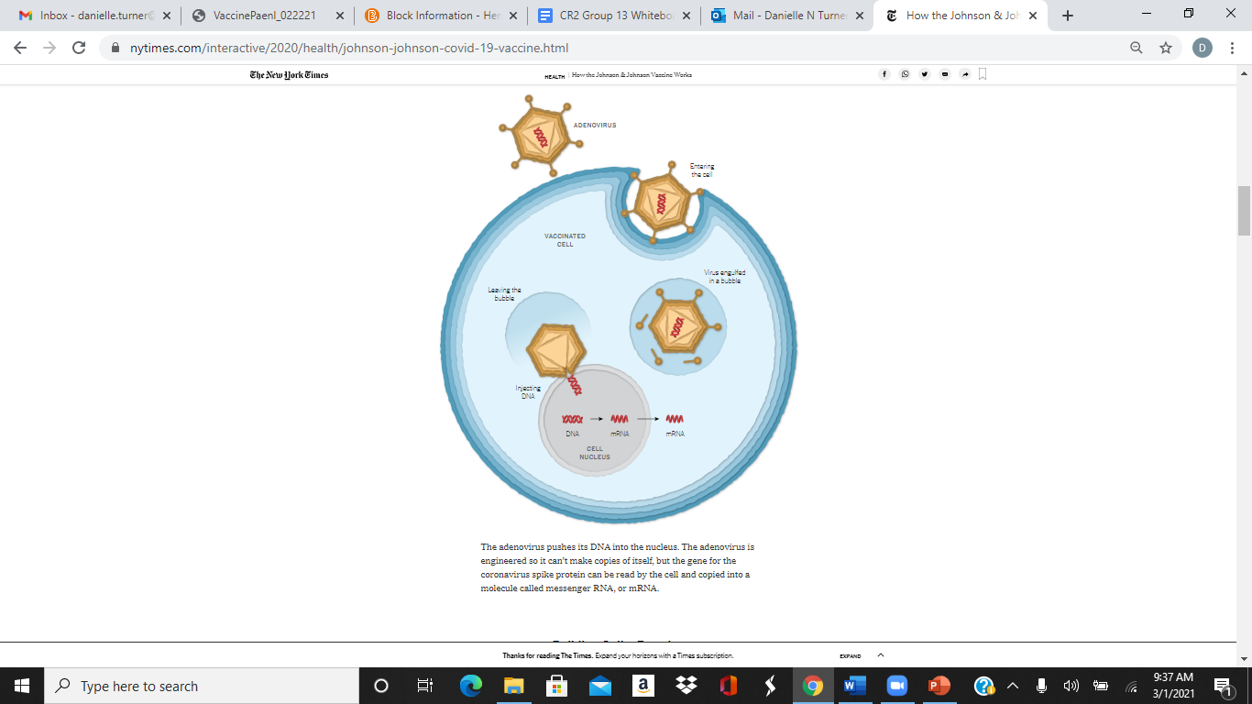
Comparing efficacy of anti-COVID mRNA with other, older vaccines
>18yo >16yo
https://www.nytimes.com/interactive/2020/health/johnson-johnson-covid-19-vaccine.html
BBC Moderna vaccine safe and effective, say US experts

Slide 7
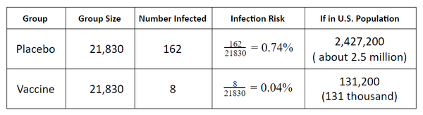
How vaccine efficacy is calculated:
Pfizer clinical trials
Infection Risk: The ~43,660 subjects were split evenly between the placebo and vaccine groups (about 21,830 subjects per group).
https://www.nytimes.com/2020/12/13/learning/what-does-95-effective-mean-teaching-the-math-of-vaccine-efficacy.html

Slide 8
How vaccine efficacy is calculated:
Pfizer clinical trials…scaled up
About 328 million (328,000,000) people live in the United States. Assume all of these people had the same infection risk as those in the placebo group during the months of this study.
https://www.nytimes.com/2020/12/13/learning/what-does-95-effective-mean-teaching-the-math-of-vaccine-efficacy.html

Slide 9
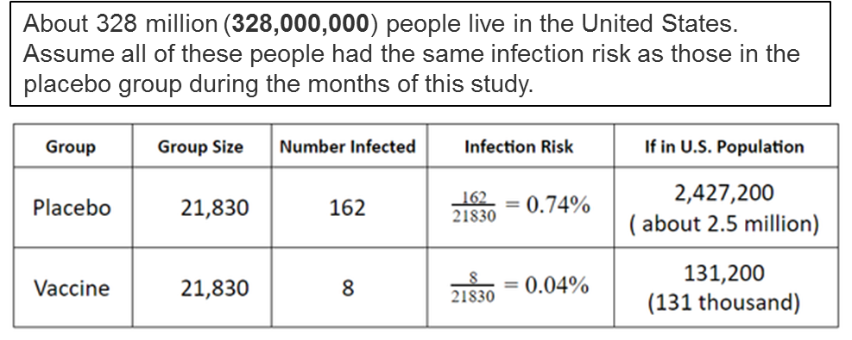
How vaccine efficacy is calculated:
Pfizer clinical trials
Efficacy:
1.) Find the difference between the risks in both groups:
0.74% - 0.04% = 0.7%
2.) Scale the percentage point difference in risks by the original infection risk:
Results: Under the same conditions as the study, the vaccine reduces the risk of infection by 95%.
https://www.nytimes.com/2020/12/13/learning/what-does-95-effective-mean-teaching-the-math-of-vaccine-efficacy.html

Slide 10
Pfizer COVID-19 vaccine FDA report released ahead of emergency use meeting

Slide 11
Pfizer COVID-19 vaccine FDA report released ahead of emergency use meeting

Slide 12
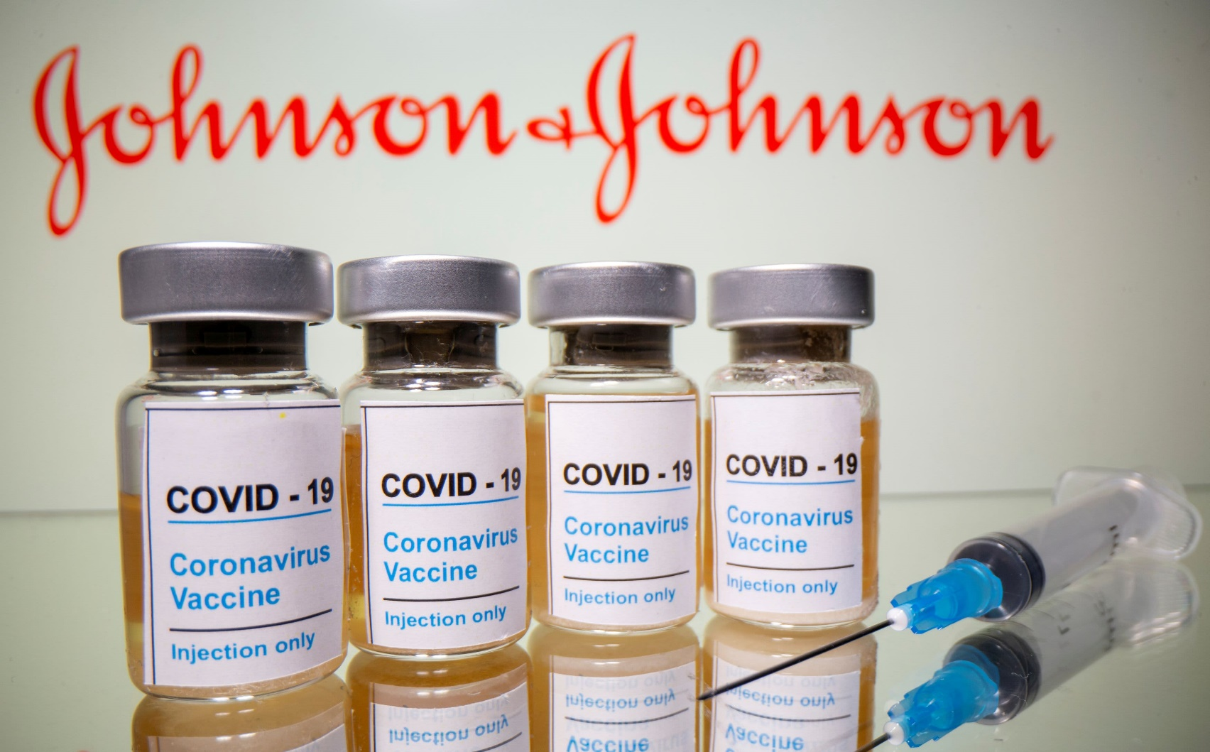
~45,000 participants
https://www.cnbc.com/2020/12/18/jj-enrolls-about-45000-participants-for-late-stage-covid-vaccine-trial-.html

Slide 13
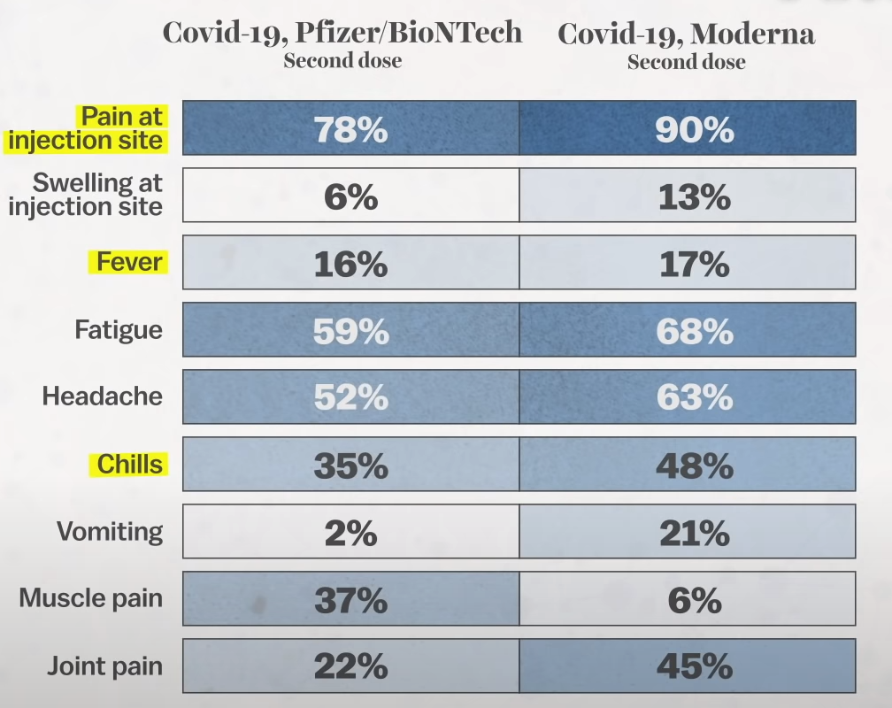
https://www.vox.com/22278795/vaccine-side-effects-moderna-pfizer-covid-19

Slide 14
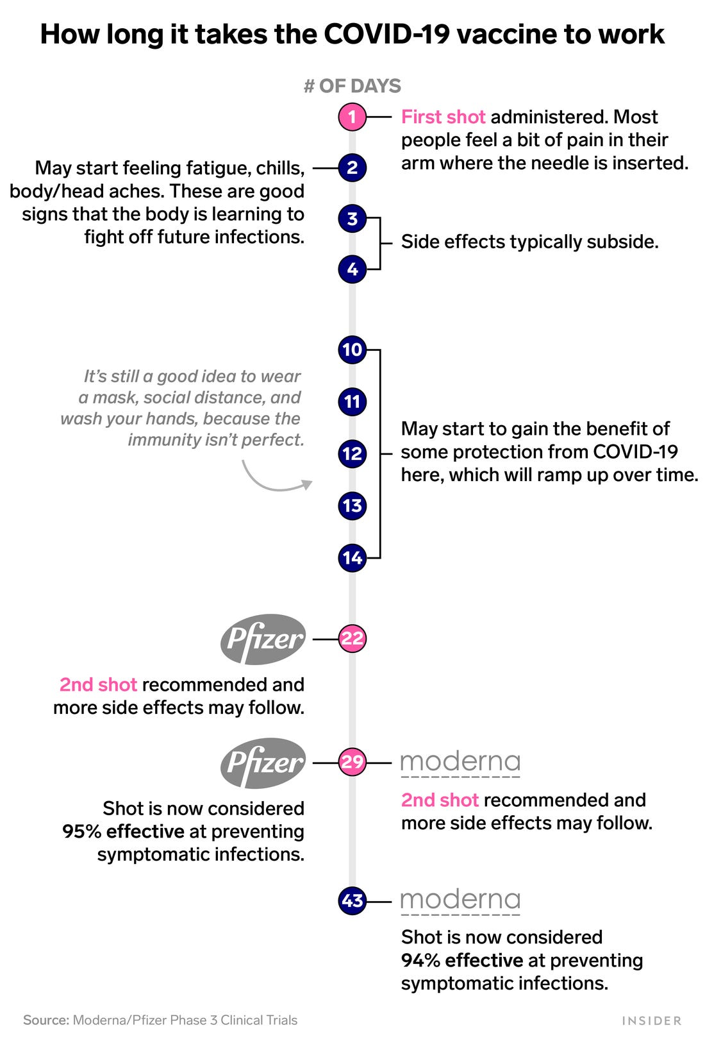
COVID-19 vaccine: How long side effects last, when protection kicks in
From how long it takes to build immunity to info on Moderna’s variant booster

Slide 15
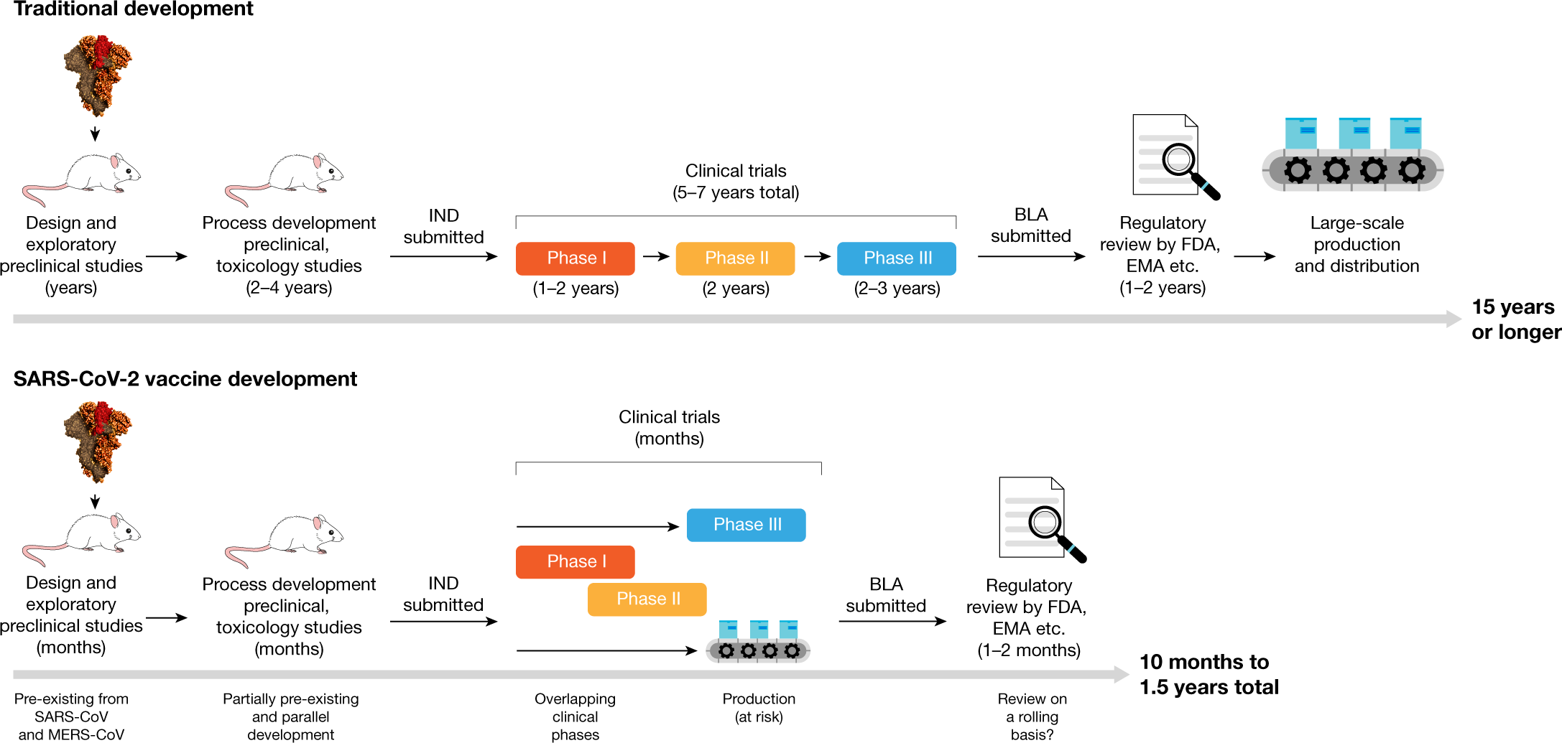
Vaccine development & approval timeline
Emergency Use Authorization (EUA)
SARS-CoV-2 vaccines in development
Notes:
Traditional vaccine development can take 15 years or more, starting with a lengthy discovery phase in which vaccines are designed and exploratory preclinical experiments are conducted. This is usually followed by a phase in which more formal preclinical experiments and toxicology studies are performed and in which production processes are developed. During this process an investigational new drug (IND) application is filed and the vaccine candidate then enters phase I, II and III trials. If, when phase III trials are completed, the predetermined end points have been met, a biologics licence application (BLA) is filed, reviewed by regulatory agencies and finally the vaccine is licensed. After that point, large-scale production begins. Vaccine development for SARS-CoV-2 is following an accelerated timeline. Because of knowledge gained from the initial development of vaccines for SARS-CoV and MERS-CoV, the discovery phase was omitted. Existing processes were adopted, and phase I/II trials were started. Phase III trials were initiated after the interim analysis of phase I/II results, with several clinical trial stages running in parallel. In the meantime, vaccine producers have started the large-scale production of several vaccine candidates, at risk. The exact pathway by which these vaccine candidates will be licensed—for example, through an initial emergency use authorization—is not yet clear.

